Slide 1

Clinic Management System
IST 659 - Final Project
Praneshwar Srinivasan
Sonamgyalpo Sherpa
Neel Samant

Slide 2
Project goals
Major functions of Database systems are:
What Data to collect?
Patient’s data is to be collected which includes contact details, ailment and location
The clinic data is to be collected which includes location, capacity, etc.
The data of doctors employed by the clinic is required
The data consisting of the departments in which the doctors operate is collected
The data of medicines available and required in the pharmacy is collected

Slide 3
Project Goals
Who can input the data?
Patients
Doctor
Administrative staff
Who can query the data?
Patients
Doctors
Administrative staff

Slide 4
Project Goals
Major Data questions?
How many doctors have been employed by the clinic?
How many patients have been registered in the clinic?
Find the quantity medicines available according to the dosage in the pharmacy.
How many patients are being treated by a single doctor?
How can the patients access the clinic’s website?
Which clinic has the highest number of patients registered?
How can a patient contact a doctor depending on his/her ailment?

Slide 5
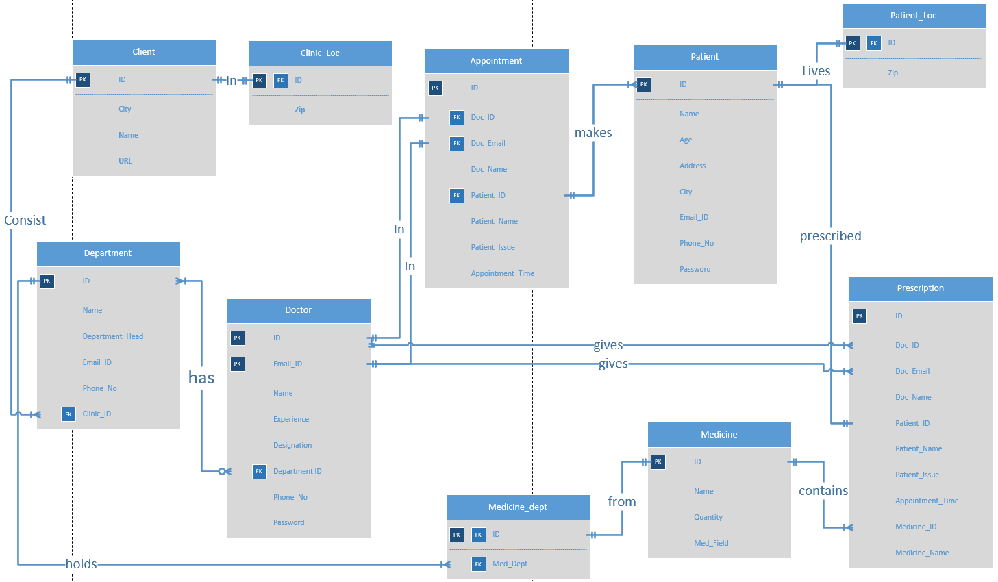
Entity Relationship diagram

Slide 6
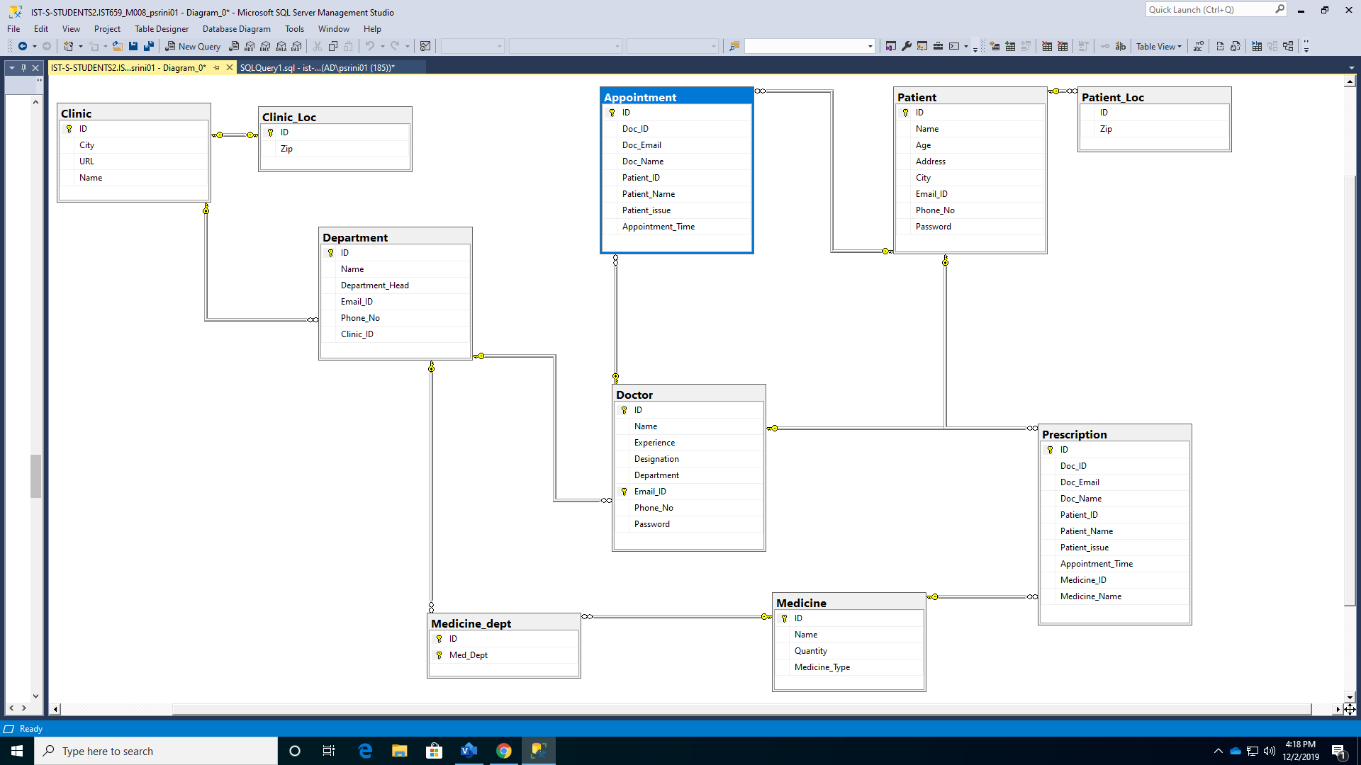
ER Diagram - SQL

Slide 7
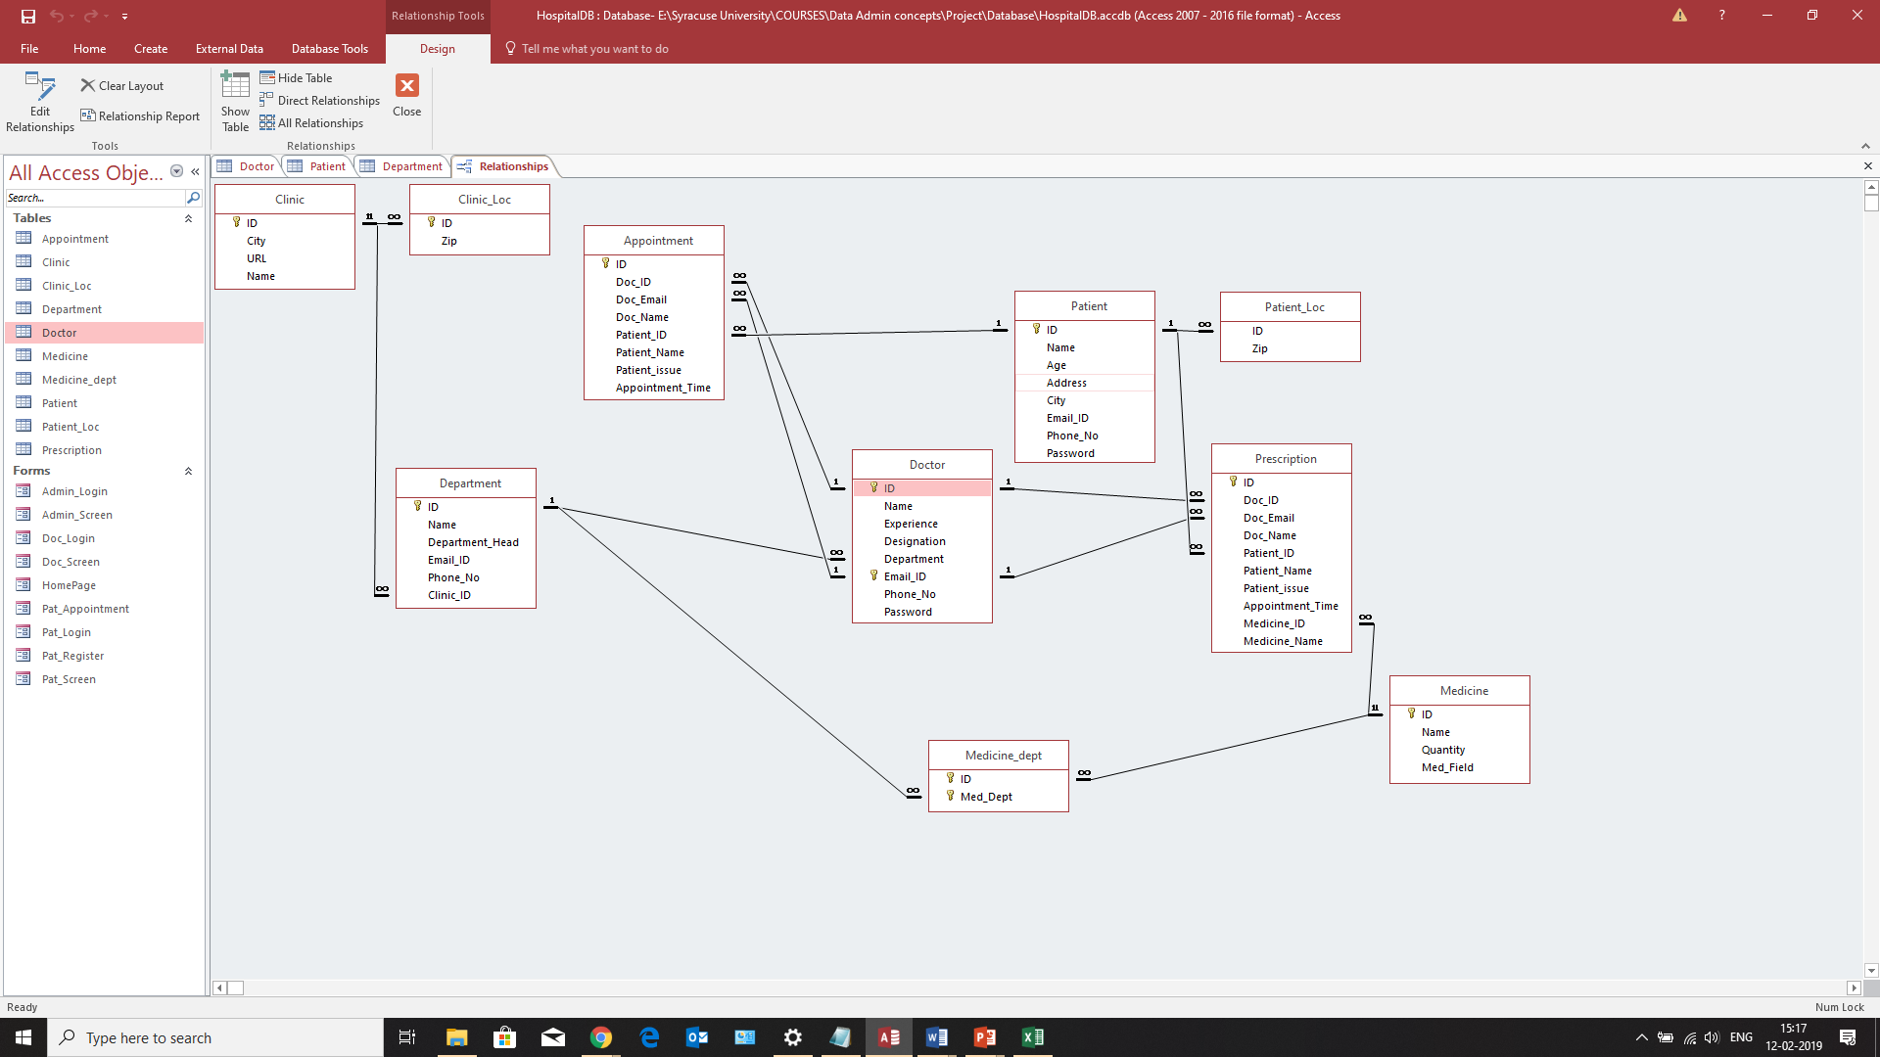
Access Relationship Diagram

Slide 8
Forms
Total Number of Tables : 10
Total Number of Forms : 15
Number of Forms that you created so far : 14
HomePage Form (Y): User selects the type of login (Doctor, Patient or Admin)
Pat_Login Form (Y): Patient Login Screen for Entering Username & Password
Doc_Login Form (Y): Doctor Login Screen for Entering Username & Password
Admin_Login Form (Y): Admin Login Screen for Entering Username & Password
Pat_Register Form (Y): Patient Registration Screen for new patient registration
Pat_Screen Form (Y): Allows patient to make a new appointment or view previous appointments .
Doc_Screen Form (Y): Allows Doctor to make Prescription, View Patient list, Appointment list and Medicine list.

Slide 9
Forms
Admin_Screen Form (Y): Allows admin to Register new doctor
Pat_Appointment Form (Y): Allows Patient to make an appointment
Pat_PrevApp Form (Y): Patient can see his/her previous appointments
Pat_UpdLoc Form (N): Allows Patient to update his Address, city or Zip
Doc_Presc Form (Y): Allows Doctor to make a Prescription.
Doc_PatList Form (Y): Allows doctor to retrieve and view the patient details.
Doc_AppointList Form (Y): Allows doctor to retrieve and view the Appointment details
Doc_MedList Form (Y): Allows doctor to retrieve and view the Medicine details

Slide 10
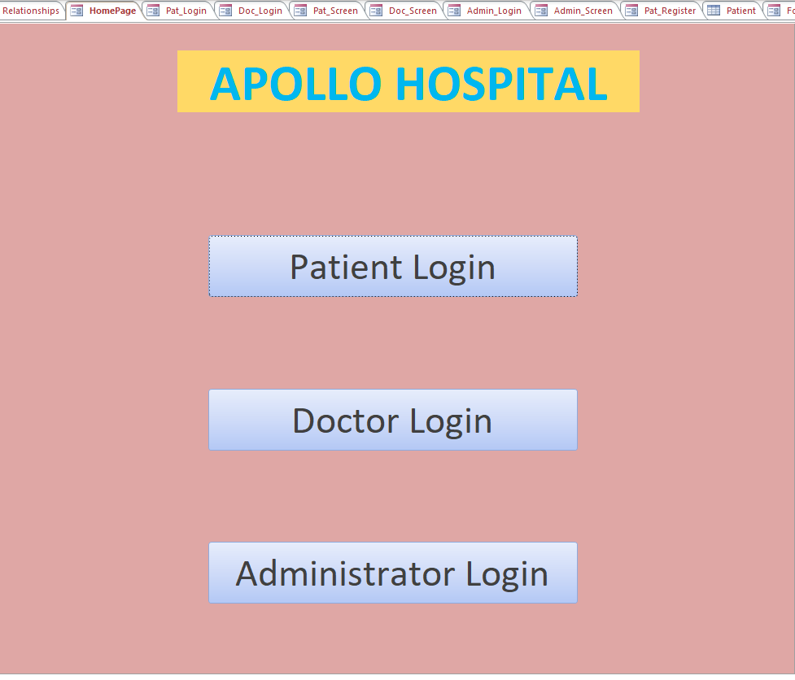
Forms

Slide 11
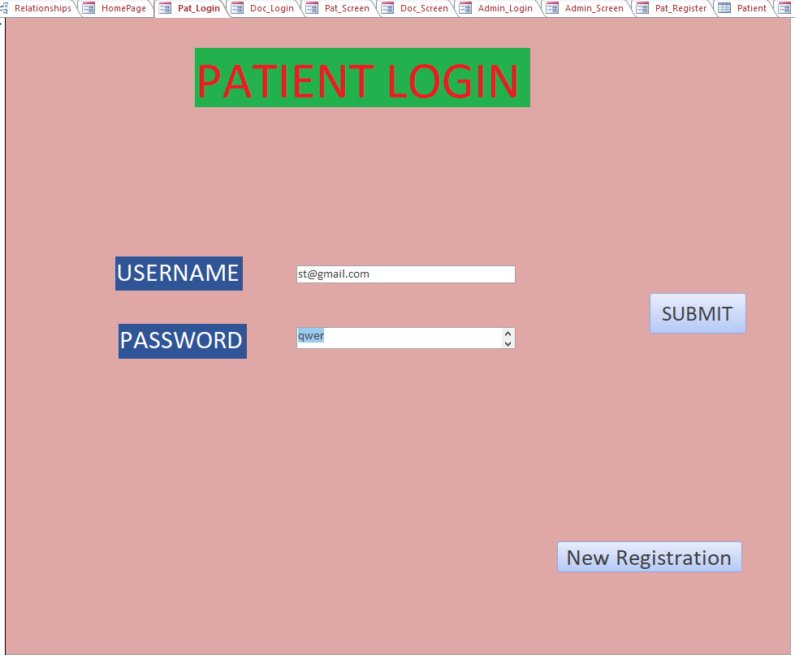
FORMs
The Username and Password entered in the text box is checked in the database to verify login

Slide 12
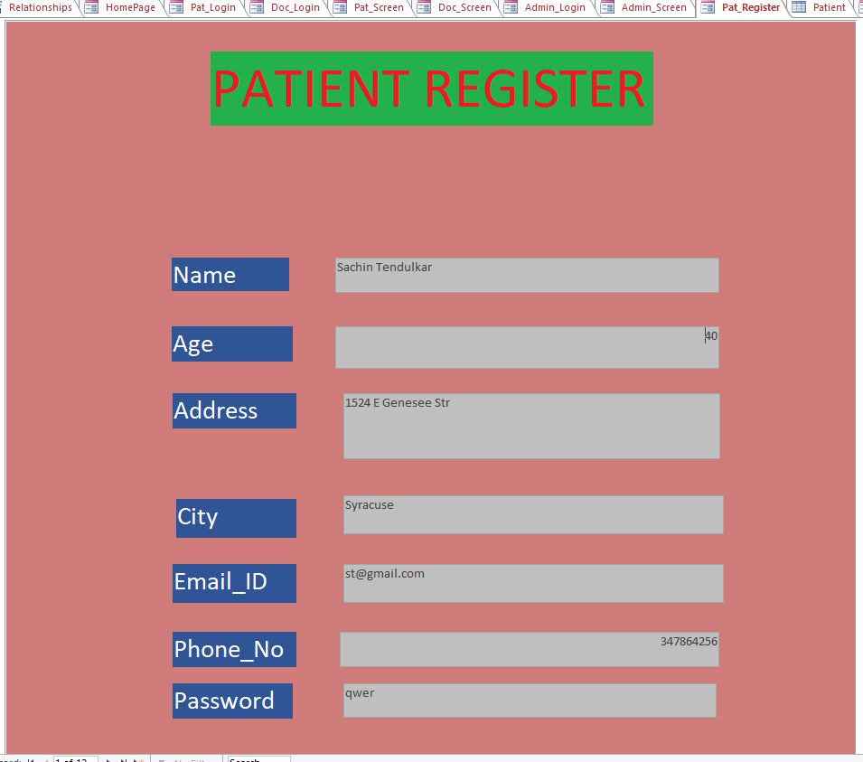
FORMs
A New Patient enters all his details to be inserted into a new row of the patient table

Slide 13
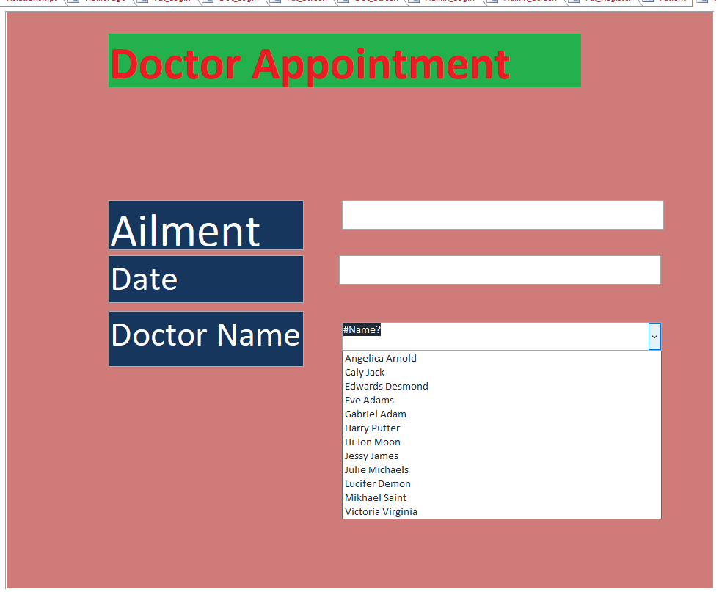
Forms
Patient uses this form to make an appointment where he can choose the doctor from the list/combo box

Slide 14
Major Data Questions
How many Doctors have been employed by the hospital?
How many Patients have been registered in the hospital?
How many patients are being treated by a doctor?
How many Doctors are grouped in a department?

Slide 15
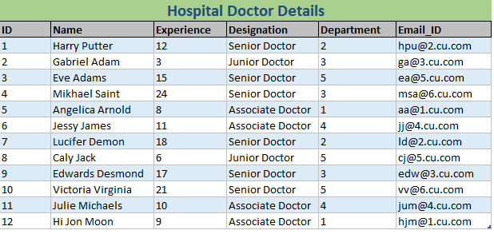
Report: 1 How many Doctors have been employed by the hospital?

Slide 16
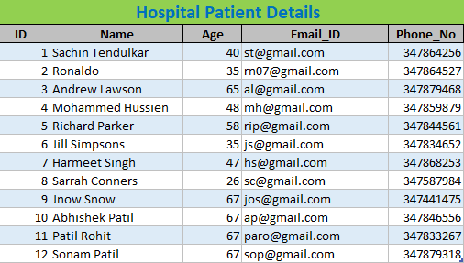
Report: 2 How many Patients have been registered in the hospital?

Slide 17
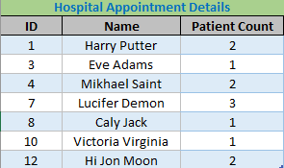
Report: 3 How many patients are being treated by a doctor?

Slide 18
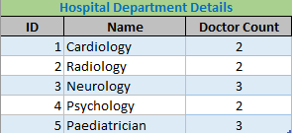
Report: 4 How many Doctors are grouped in a department?

Slide 19
Procedure
The following procedure is created to extract doctors according to the departments

Slide 20
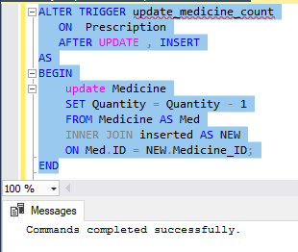
TRIGGER
The following trigger updates the medicine quantity whenever the corresponding medicine is prescribed in the prescription.

Slide 21
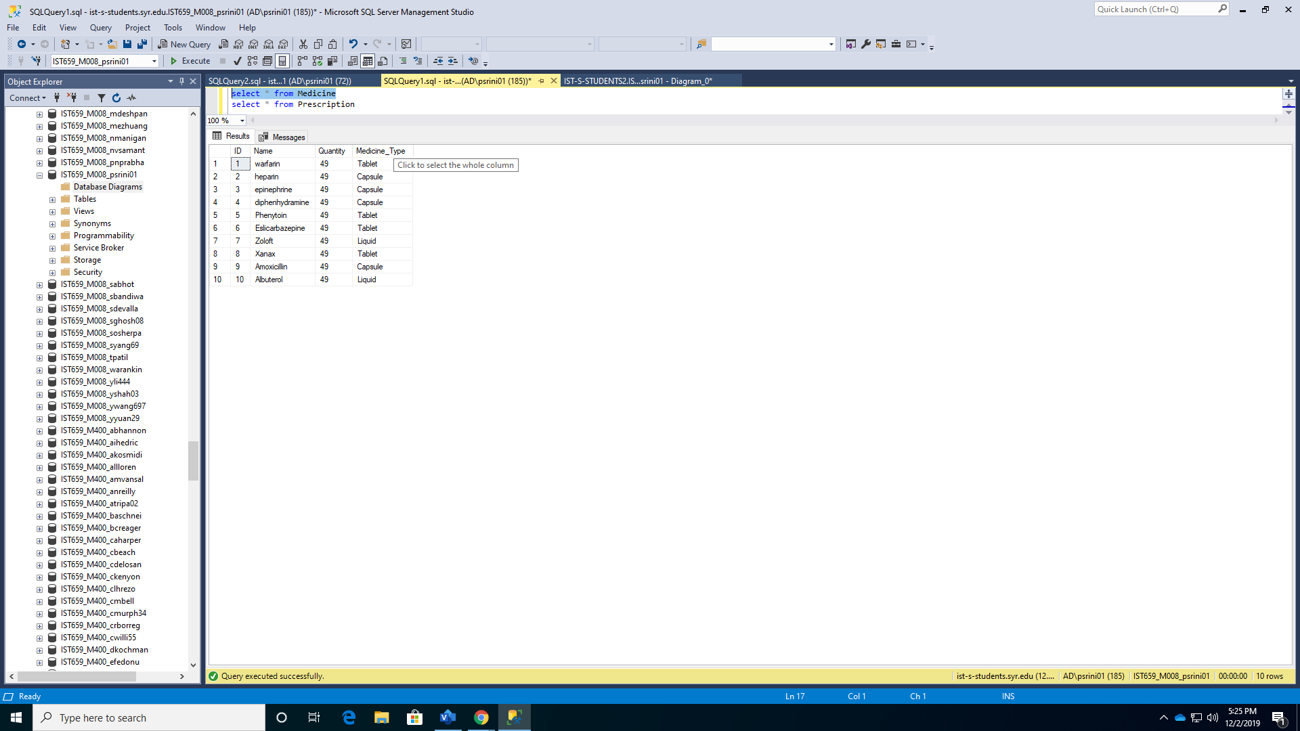
TRIGGER
Medicine Table with Quantity BEFORE Prescription table is updated

Slide 22
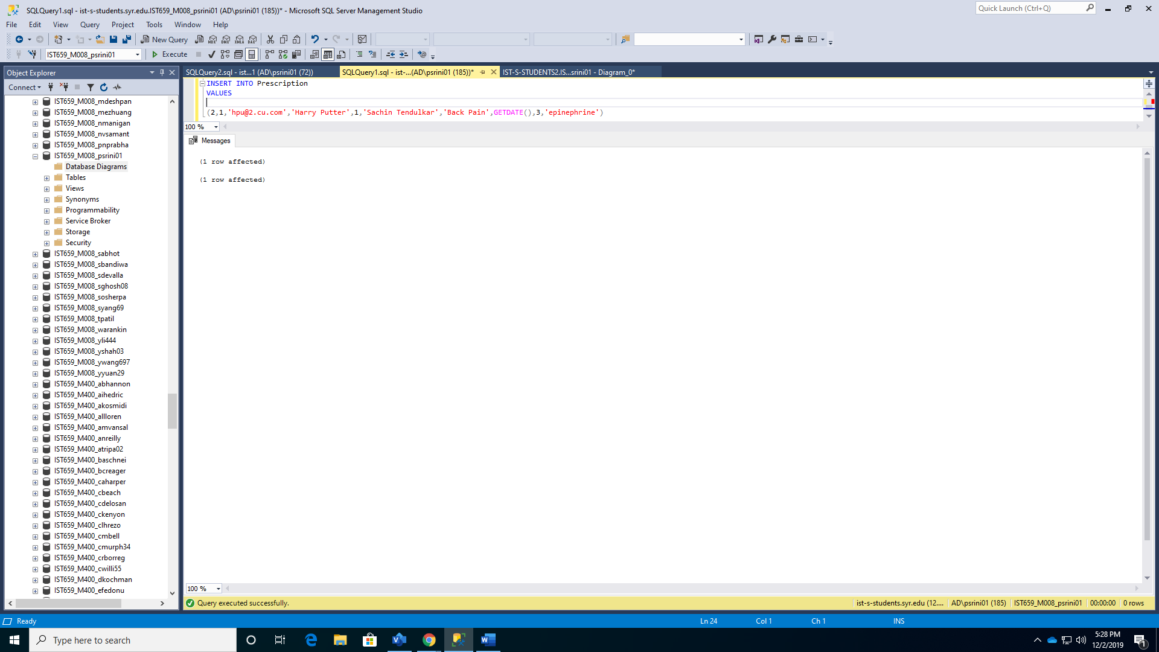
TRIGGER
Prescription table is inserted with the following value

Slide 23
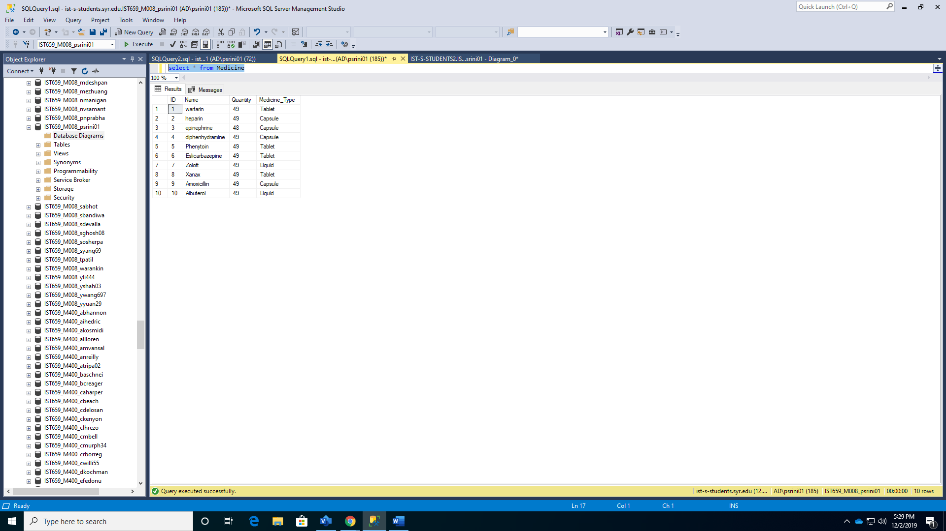
TRIGGER
Medicine Table with Quantity AFTER Prescription table is updated

